Slide 1
HealthConnect Clinic Appointment Attendance & No-Show Analysis
KOTUN AFUSAT OMOTARA
Data Analytics Track
September, 2026
Tools: Power BI | Excel | Power Query| DAX

Slide 2
Project Objective:
The objective of the Data Analytics track was to analyse HealthConnect appointment data and identify attendance and no-show patterns, validate key analytical findings, and translate the results into actionable business insights to support appointment management and decision making.

Slide 3
From Analysis to Final Decision Support
Week 4
Planning & Initial Analysis
Week 5
Dashboard Development & Exploratory Analysis
Week 6
Advanced Analysis & Decision Support
Week 7
Testing, Validation & Refinement
Week 8
Final Integration & Presentation

Slide 4





Final HealthConnect Analytics KPIs

Slide 5
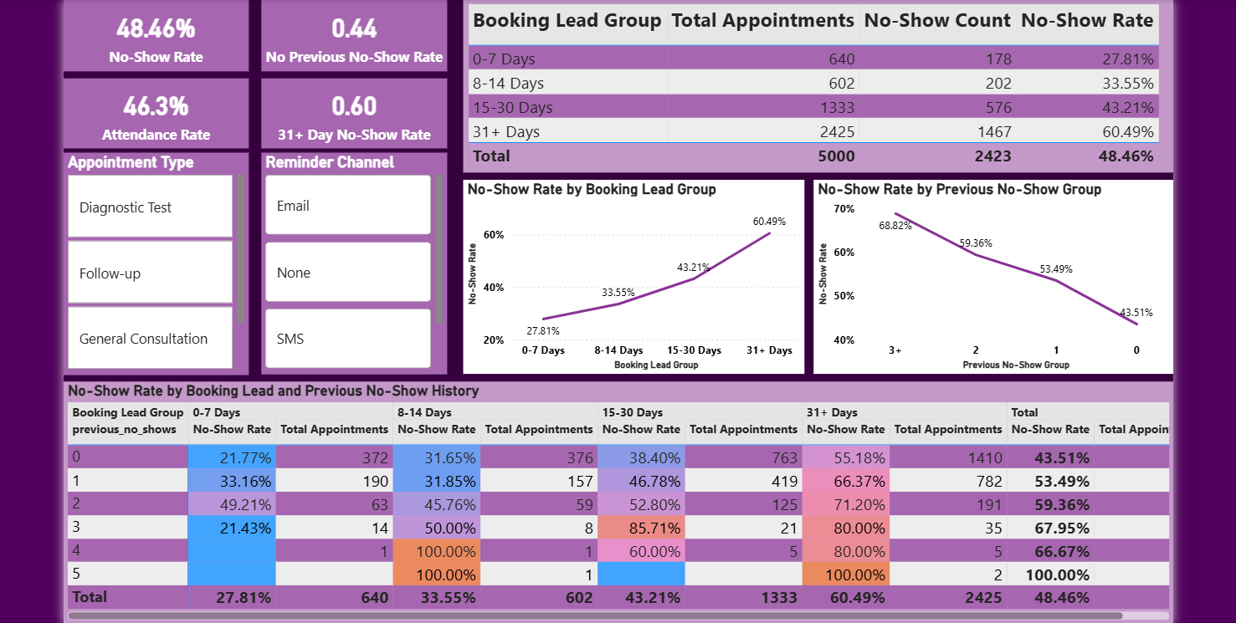
FINAL DASHBOARD

Slide 6
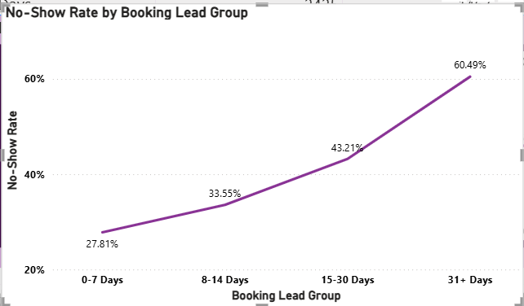
Business Implication:
Longer booking lead appointments showed higher observed no-show rates and should be monitored as a segment for appropriate reminder and administrative follow-up.

Slide 7
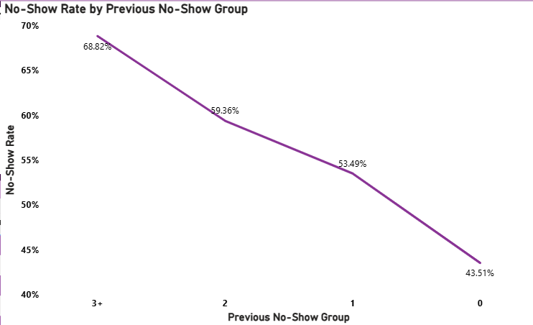
Patient with previous no-show history generally showed higher subsequent observed no-show rate.
Business Implication: Previous no-show history can be used as a segmentation variable when considering appropriate administrative follow-up

Slide 8
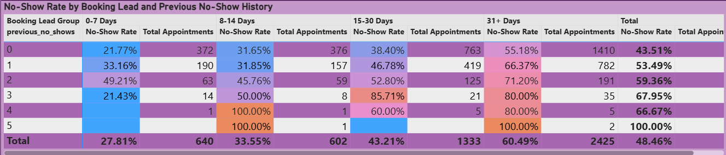
Booking lead time x Previous No-Show History
Examining booking lead time together with previous no-show history provided a more detailed view of observed no show patterns across patient segments.
Business Implication: Combining these variables can support more targeted appointment management

Slide 9
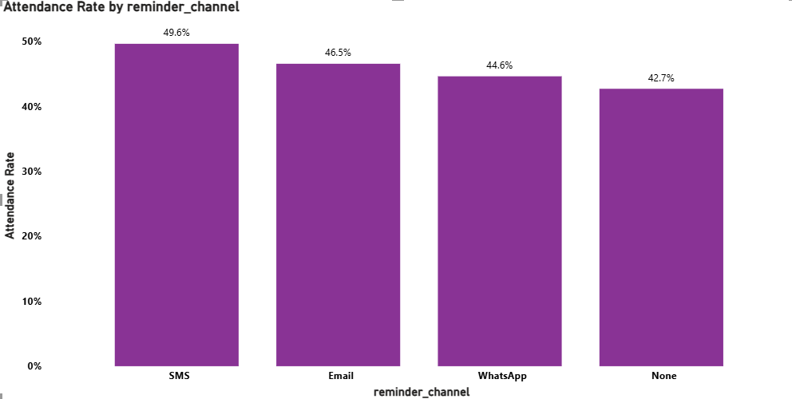
Attendance rates varied across reminder channels, with SMS recording the highest observed attendance rate. This highlights the value of monitoring reminder channel performance when managing appointment attendance

Slide 10
KEY FINDINGS
Booking Lead Time
Longer booking-lead groups showed higher observed no-show rates.
Previous No-Show History
Patients with previous no-show history generally showed higher subsequent observed no-show rates.
Combined Segmentation
Booking lead time and previous no-show history provided additional segmentation insight when examined together.
Reminder Channels
Attendance/no-show patterns varied across reminder-channel categories.

Slide 11
BUSINESS INSIGHTS AND RECOMMENDATIONS
BUSINESS INSIGTHS | BUSINESS RECOMMENDATIONS
1. Booking Lead Time Longer booking lead groups showed higher observed no-show rates. 2. Previous No-Show History Previous no-show history was associated with higher observed subsequent no-show rates. 3. Reminder Channels Reminder channels showed differences in observed attendance/no-show patterns. 4. Booking lead time and previous no-show history provided additional segmentation insight together. | Review reminder timing and appropriate administrative follow-up for longer lead appointments. 2. Target Appropriate Administrative Attention Use previous no-show history as a segmentation variable for administrative attention. 3. Monitor Reminder Channels Track attendance/no-show outcomes by reminder channel over time. 4. Use Combined Segmentation Consider booking lead time and previous no-show history together when reviewing appointment-management priorities.

Slide 12
CROSS TRACK COLLABORATION
Data Analytics → Data Science
Validated analytical findings and candidate variables were documented as inputs for potential predictive modelling, including booking lead time, previous no-show history, reminder channel, and their interaction.
Status
Formal Data Science testing/model validation was not completed due to collaborator availability.
Contribution
The Analytics track provided validated findings and proposed analytical variables as a structured handoff for future testing.

Slide 13
BUSINESS VALUE
The final analytics solution provides HealthConnect with evidence-based visibility into appointment attendance and no-show patterns. The findings can support more targeted administrative attention, appointment management review and better use of available appointment capacity.
LIMITATIONS
Observed relationships do not establish causation.
Segment volume should be considered when interpreting rates.
Reminder channel differences do not prove causation.
Patterns may change with another dataset or time periods.
Formal predictive model performance was not established.

Slide 14
HealthConnect Clinic Appointment Attendance & No-Show Analysis
Data Analytics Track
THANK YOU.

